Slide 1


Big Data Infrastructure
Session 10: Beyond MapReduce — Graph Processing
Jimmy Lin
University of Maryland
Monday, April 13, 2015
This work is licensed under a Creative Commons Attribution-Noncommercial-Share Alike 3.0 United States See http://creativecommons.org/licenses/by-nc-sa/3.0/us/ for details

Slide 2
Today’s Agenda
What makes graph processing hard?
Graph processing frameworks
Twitter case study

Slide 3
What makes graph processing hard?
Lessons learned so far:
Partition
Replicate
Reduce cross-partition communication
What makes MapReduce “work”?

Slide 4
Characteristics of Graph Algorithms
What are some common features of graph algorithms?
Graph traversals
Computations involving vertices and their neighbors
Passing information along graph edges
What’s the obvious idea?
Keep “neighborhoods” together!

Slide 5
Simple Partitioning Techniques
Hash partitioning
Range partitioning on some underlying linearization
Web pages: lexicographic sort of domain-reversed URLs
Social networks: sort by demographic characteristics

Slide 6
Country Structure in Facebook
Analysis of 721 million active users (May 2011)
54 countries w/ >1m active users, >50% penetration
Ugander et al. (2011) The Anatomy of the Facebook Social Graph.

Slide 7
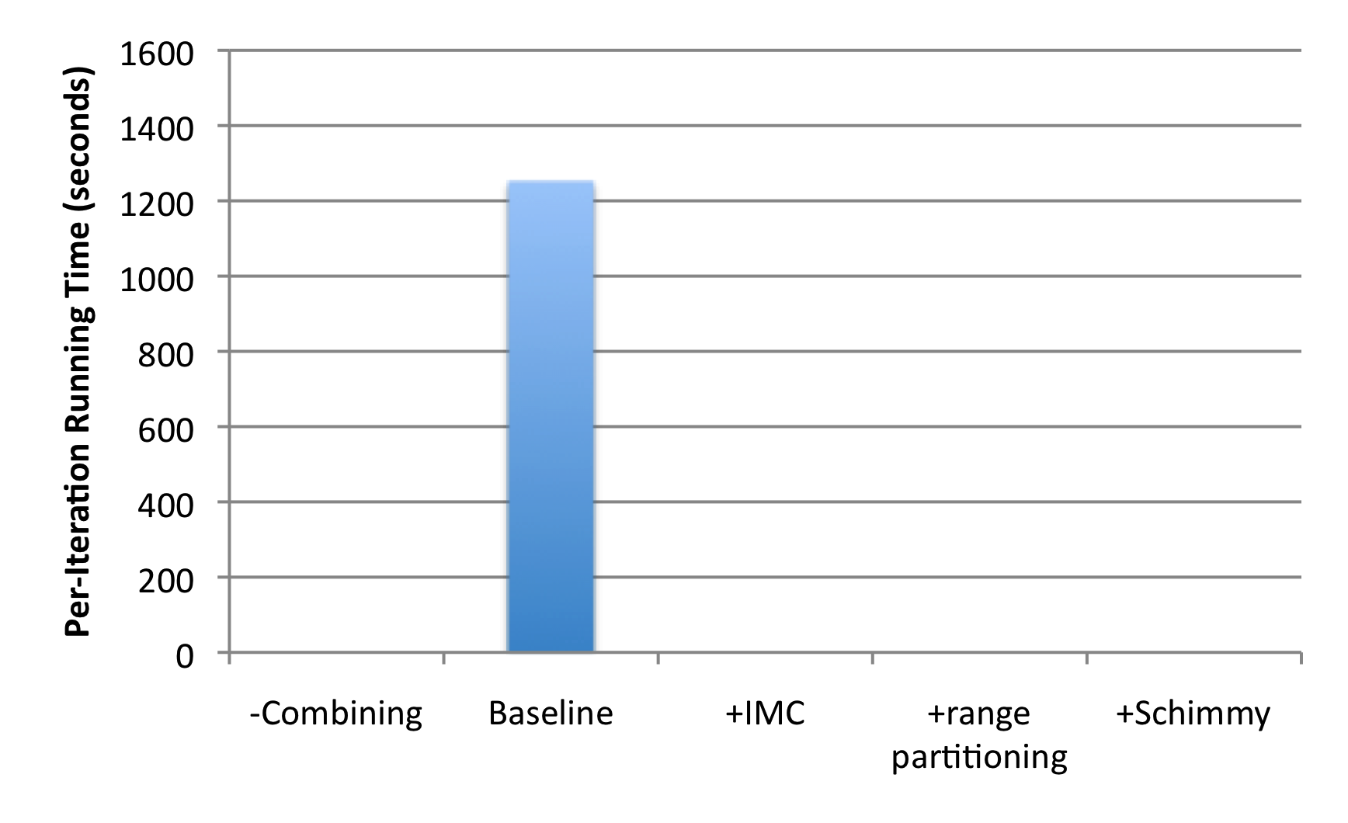
How much difference does it make?
“Best Practices”
PageRank over webgraph (40m vertices, 1.4b edges)
Lin and Schatz. (2010) Design Patterns for Efﬁcient Graph Algorithms in MapReduce.

Slide 8
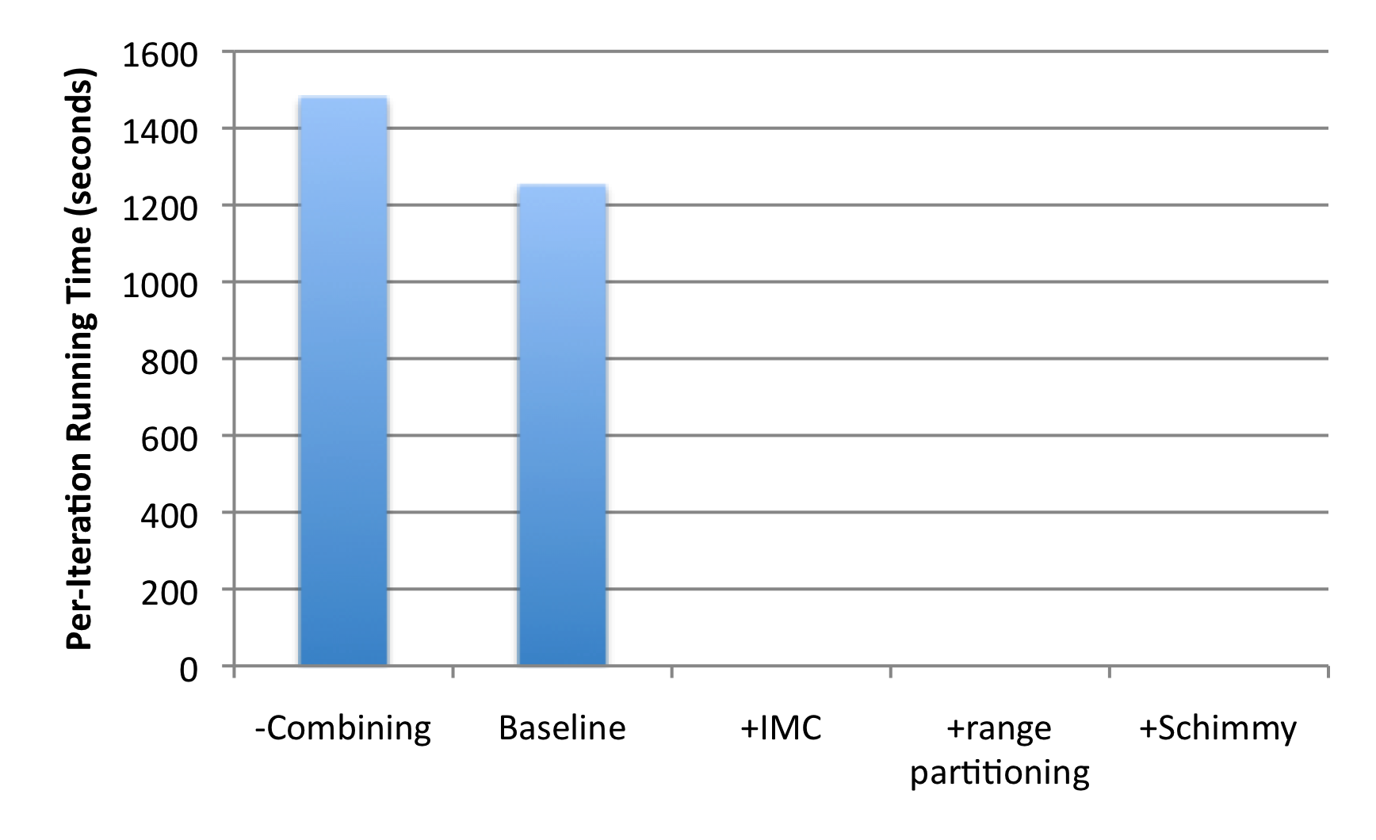
How much difference does it make?
+18%
1.4b
674m
PageRank over webgraph (40m vertices, 1.4b edges)
Lin and Schatz. (2010) Design Patterns for Efﬁcient Graph Algorithms in MapReduce.

Slide 9
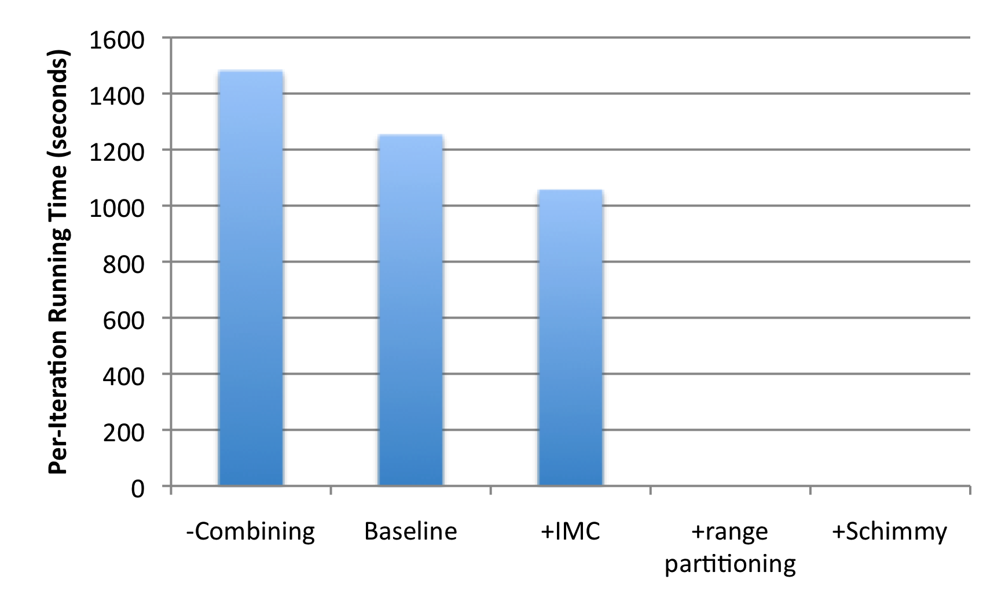
How much difference does it make?
+18%
1.4b
674m
-15%
PageRank over webgraph (40m vertices, 1.4b edges)
Lin and Schatz. (2010) Design Patterns for Efﬁcient Graph Algorithms in MapReduce.

Slide 10
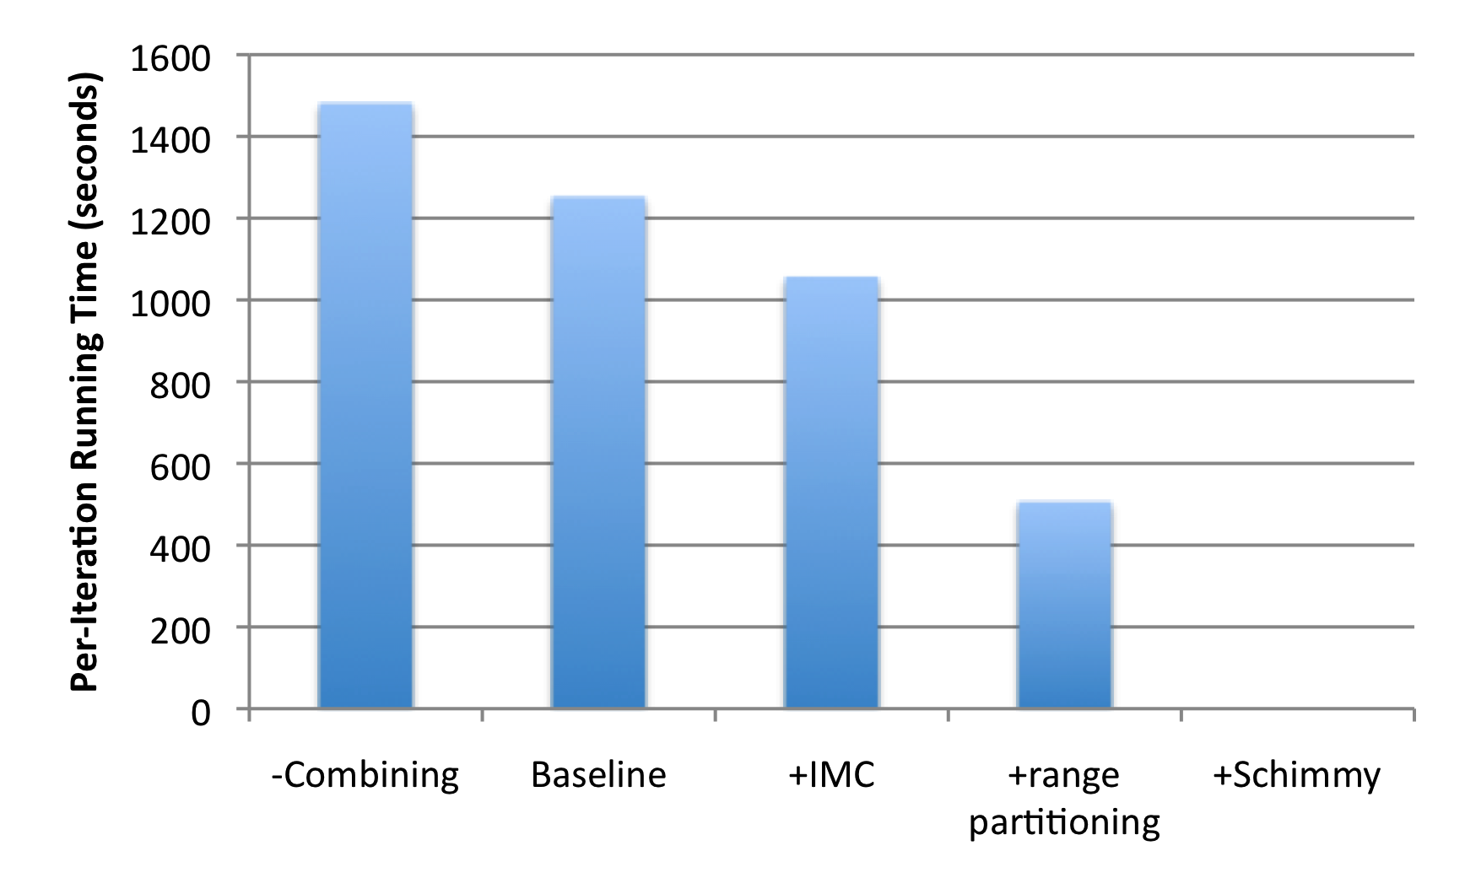
How much difference does it make?
+18%
1.4b
674m
-15%
-60%
86m
PageRank over webgraph (40m vertices, 1.4b edges)
Lin and Schatz. (2010) Design Patterns for Efﬁcient Graph Algorithms in MapReduce.

Slide 11
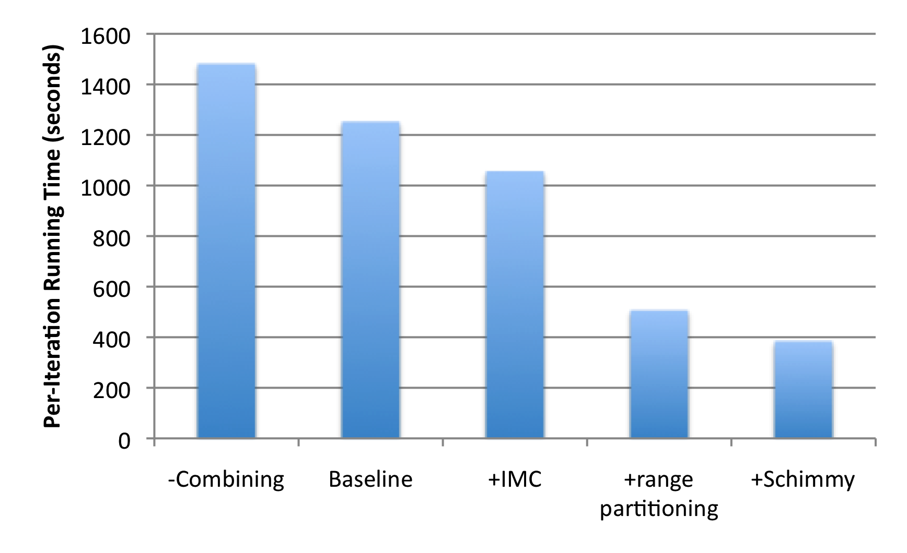
How much difference does it make?
+18%
1.4b
674m
-15%
-60%
86m
-69%
PageRank over webgraph (40m vertices, 1.4b edges)
Lin and Schatz. (2010) Design Patterns for Efﬁcient Graph Algorithms in MapReduce.

Slide 12
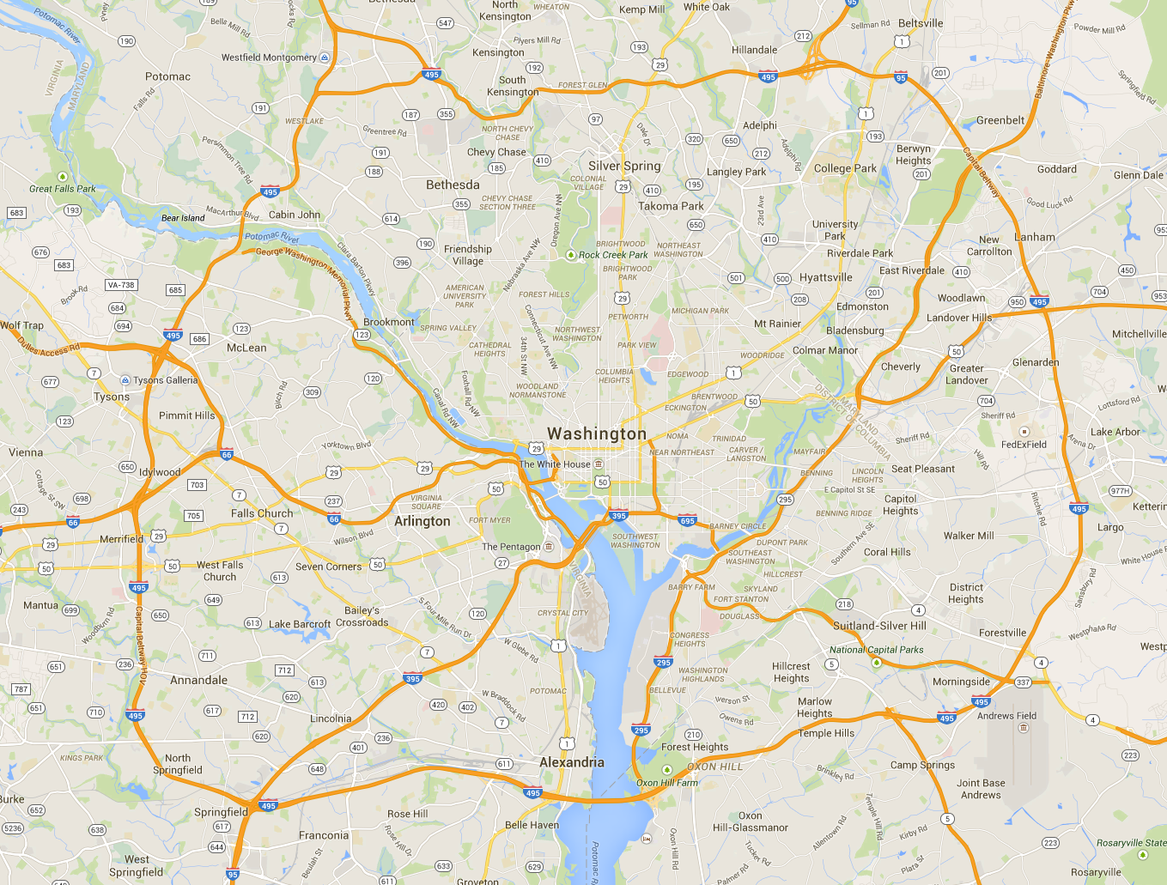
Aside: Partitioning Geo-data

Slide 13
Geo-data = regular graph

Slide 14
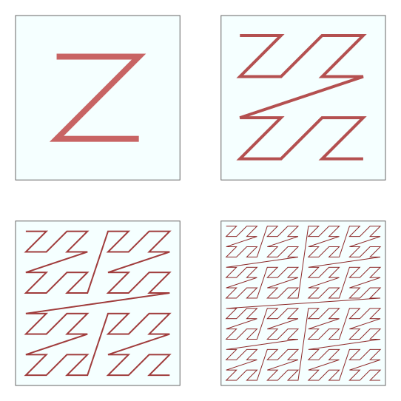
Space-filling curves: Z-Order Curves

Slide 15
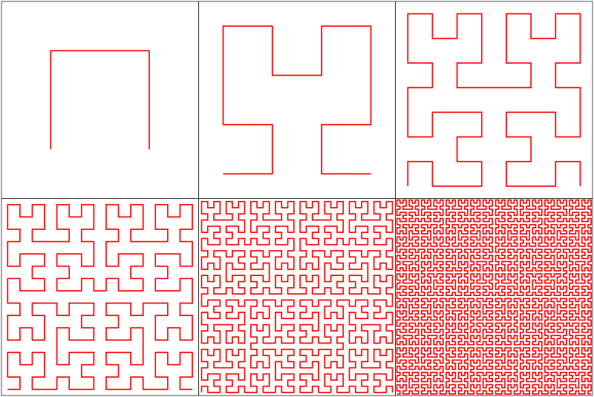
Space-filling curves: Hilbert Curves

Slide 16
General-Purpose Graph Partitioning
Karypis and Kumar. (1998) A Fast and High Quality Multilevel Scheme for Partitioning Irregular Graphs.

Slide 17
Graph Coarsening
Karypis and Kumar. (1998) A Fast and High Quality Multilevel Scheme for Partitioning Irregular Graphs.

Slide 18
Partition

Slide 19
Partition

Slide 20
Partition + Replicate
What’s the issue?
Solutions?

Slide 21
Neighborhood Replication
What’s the cost of replicating n-hop neighborhoods?
What’s the more general challenge?
Ugander et al. (2011) The Anatomy of the Facebook Social Graph.

Slide 22
What makes graph processing hard?
It’s tough to apply our “usual tricks” :
Partition
Replicate
Reduce cross-partition communication

Slide 23
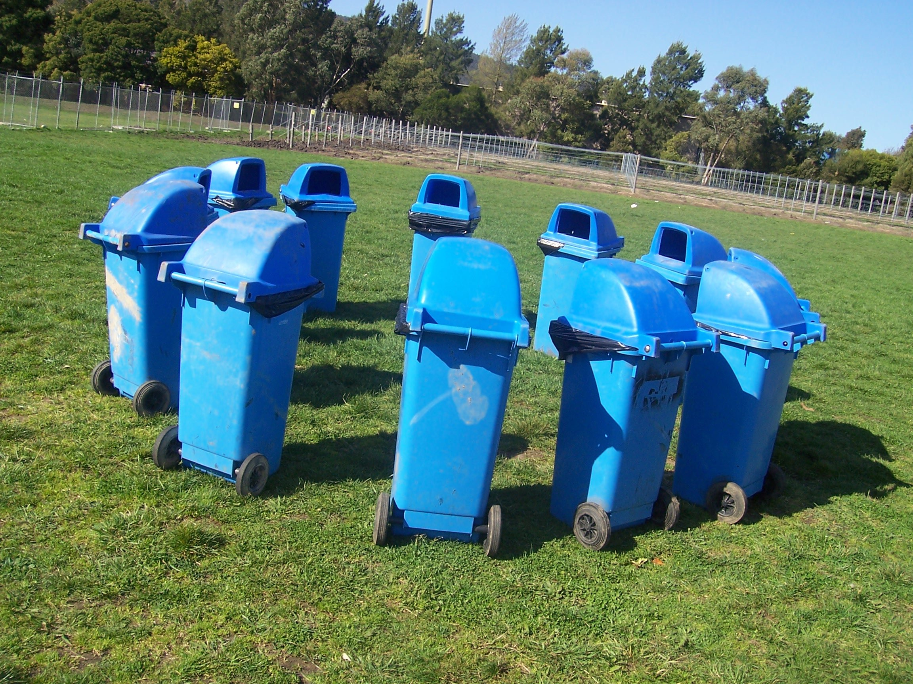
Graph Processing Frameworks
Source: Wikipedia (Waste container)

Slide 24
Pregel: Computational Model
Based on Bulk Synchronous Parallel (BSP)
Computational units encoded in a directed graph
Computation proceeds in a series of supersteps
Message passing architecture
Each vertex, at each superstep:
Receives messages directed at it from previous superstep
Executes a user-defined function (modifying state)
Emits messages to other vertices (for the next superstep)
Termination:
A vertex can choose to deactivate itself
Is “woken up” if new messages received
Computation halts when all vertices are inactive
Source: Malewicz et al. (2010) Pregel: A System for Large-Scale Graph Processing. SIGMOD.

Slide 25
Pregel
superstep t
superstep t+1
superstep t+2
Source: Malewicz et al. (2010) Pregel: A System for Large-Scale Graph Processing. SIGMOD.

Slide 26
Pregel: Implementation
Master-Slave architecture
Vertices are hash partitioned (by default) and assigned to workers
Everything happens in memory
Processing cycle:
Master tells all workers to advance a single superstep
Worker delivers messages from previous superstep, executing vertex computation
Messages sent asynchronously (in batches)
Worker notifies master of number of active vertices
Fault tolerance
Checkpointing
Heartbeat/revert
Source: Malewicz et al. (2010) Pregel: A System for Large-Scale Graph Processing. SIGMOD.

Slide 27
Pregel: PageRank
class PageRankVertex : public Vertex<double, void, double> {
public:
virtual void Compute(MessageIterator* msgs) {
if (superstep() >= 1) {
double sum = 0;
for (; !msgs->Done(); msgs->Next())
sum += msgs->Value();
*MutableValue() = 0.15 / NumVertices() + 0.85 * sum;
}
if (superstep() < 30) {
const int64 n = GetOutEdgeIterator().size();
SendMessageToAllNeighbors(GetValue() / n);
} else {
VoteToHalt();
}
}
};
Source: Malewicz et al. (2010) Pregel: A System for Large-Scale Graph Processing. SIGMOD.

Slide 28
Pregel: SSSP
class ShortestPathVertex : public Vertex<int, int, int> {
void Compute(MessageIterator* msgs) {
int mindist = IsSource(vertex_id()) ? 0 : INF;
for (; !msgs->Done(); msgs->Next())
mindist = min(mindist, msgs->Value());
if (mindist < GetValue()) {
*MutableValue() = mindist;
OutEdgeIterator iter = GetOutEdgeIterator();
for (; !iter.Done(); iter.Next())
SendMessageTo(iter.Target(),
mindist + iter.GetValue());
}
VoteToHalt();
}
};
Source: Malewicz et al. (2010) Pregel: A System for Large-Scale Graph Processing. SIGMOD.

Slide 29
Pregel: Combiners
class MinIntCombiner : public Combiner<int> {
virtual void Combine(MessageIterator* msgs) {
int mindist = INF;
for (; !msgs->Done(); msgs->Next())
mindist = min(mindist, msgs->Value());
Output("combined_source", mindist);
}
};
Source: Malewicz et al. (2010) Pregel: A System for Large-Scale Graph Processing. SIGMOD.

Slide 31
Giraph Architecture
Master – Application coordinator
Synchronizes supersteps
Assigns partitions to workers before superstep begins
Workers – Computation & messaging
Handle I/O – reading and writing the graph
Computation/messaging of assigned partitions
ZooKeeper
Maintains global application state
Giraph slides borrowed from Joffe (2013)

Slide 32
Giraph Dataflow
1
2
3
Loading the graph
Compute/Iterate
Storing the graph
Input format
In-memory graph
Output format
Split 0
Worker 0
Load / Send
Graph
Compute / Send
Messages
Part 0
Part 0
Worker 0
Worker 0
Split 1
Part 1
Part 0
Master
Split 2
Master
Part 1
Part 1
Split 3
Load / Send
Graph
Part 2
Compute / Send
Messages
Part 2
Worker 1
Part 3
Worker 1
Worker 1
Part 2
Split 4
Part 3
Part 3
Split
Send stats / iterate!

Slide 33
Giraph Lifecycle
Vertex Lifecycle
Vote to Halt
Active
Inactive
Input
Received Message
Compute Superstep
All Vertices Halted?
Yes
Output
No
Master halted?
Yes
No

Slide 34
Giraph Example

Slide 35
Execution Trace
Processor 1
5
5
5
5
Processor 2
1
1
5
5
5
2
2
2
5
5
Time

Slide 36
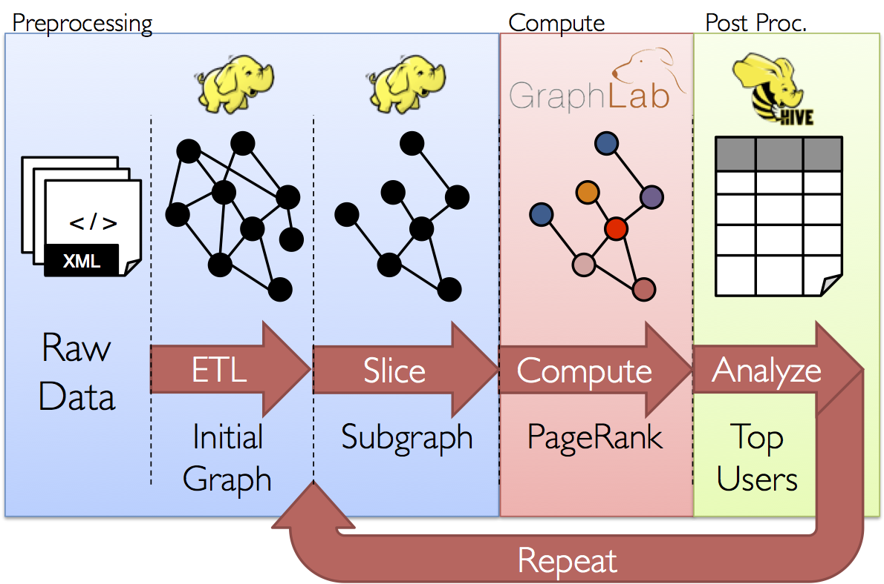
GraphX: Motivation

Slide 37
GraphX = Spark for Graphs
Integration of record-oriented and graph-oriented processing
Extends RDDs to Resilient Distributed Property Graphs
Property graphs:
Present different views of the graph (vertices, edges, triplets)
Support map-like operations
Support distributed Pregel-like aggregations

Slide 38
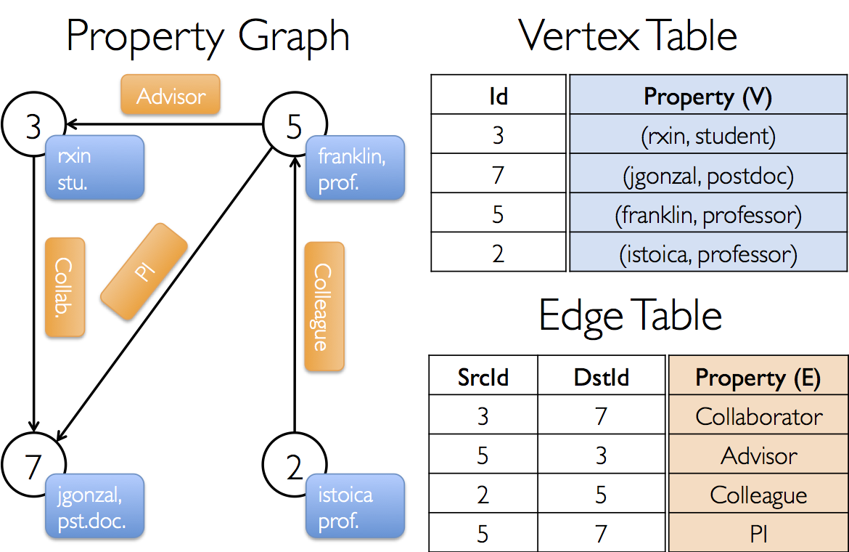
Property Graph: Example

Slide 39
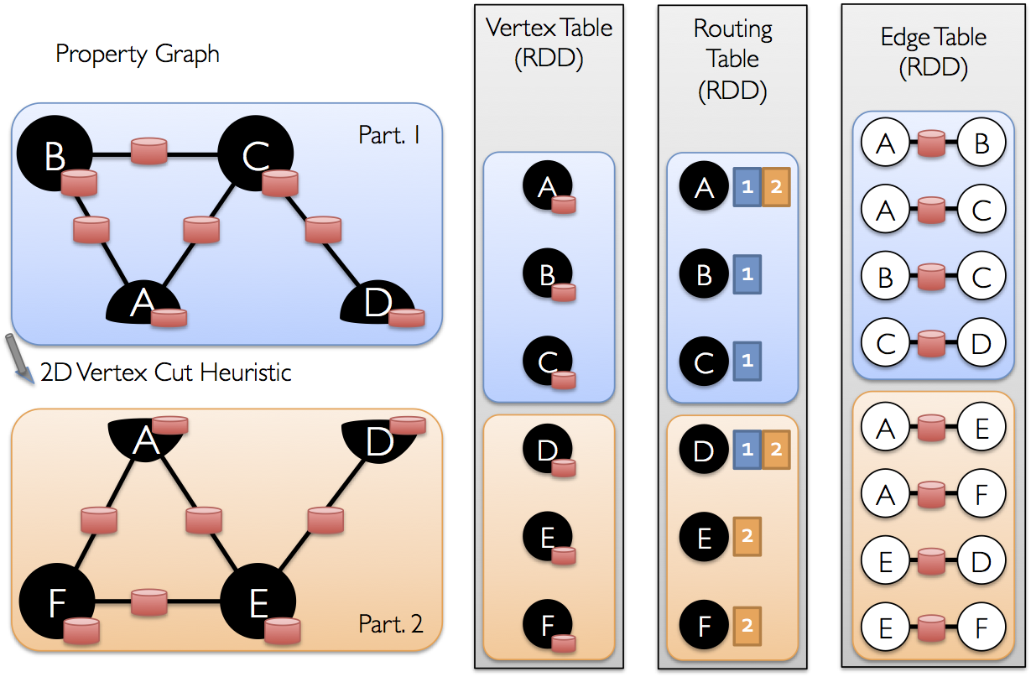
Underneath the Covers

Slide 40
Today’s Agenda
What makes graph processing hard?
Graph processing frameworks
Twitter case study

Slide 41

Questions?
Source: Wikipedia (Japanese rock garden)

